Slide 1
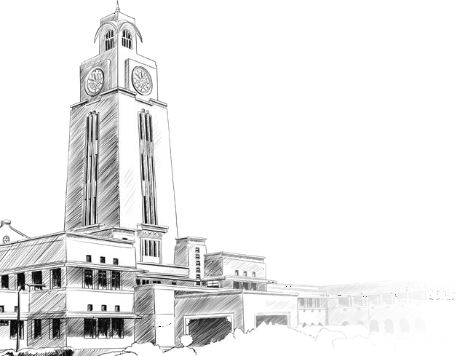
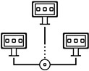



CCZG501
Introduction to
Parallel and Distributed Programming
CS1
Introduction
Dr. Sachin D N
sachin.dn@wilp.bits-pilani.ac.in

Slide 2
Agenda
Parallel and Distributed Systems (PDS)
Libraries and APIs for Programming PDS
Cloud and Big Data System use cases in need of programming a PDS

Slide 3
Why to learn parallel computing?
Building faster serial computers became constrained due to both physical and practical reasons.
The increase in serial performance slowed down because processor designs approached limits of miniaturization, clock frequency, power consumption, data transmission speed.
It is increasingly expensive to make a single processor faster. Using a larger number of moderately fast commodity processors to achieve the same (or better) performance is more practical.

Slide 4


Slide 5


Slide 6


Slide 7
General Problem
Scenario:
"You are managing a pizza delivery system for a city. During peak hours, you need to handle a massive number of incoming orders and ensure timely delivery. Each order has the following steps:
Take the order.
Assign a delivery driver.
Prepare the pizza.
Deliver the pizza.
The challenge is to process these steps as quickly and efficiently as possible during peak demand."

Slide 8
Serial Computing (Inefficient Example):A single worker processes orders one by one:
Takes an order.
Assigns a driver.
Prepares a pizza.
Waits for delivery to finish before starting the next order.
Problem: This approach creates bottlenecks and delays during peak hours.
Parallel Computing Solution:Split tasks into independent stages:
One core handles taking orders.
Another handles assigning drivers.
Multiple cores handle pizza preparation in parallel (one pizza per oven).
Deliveries occur simultaneously, with each driver responsible for one route.
Example:
10 ovens = 10 pizzas cooked at the same time, significantly reducing preparation time.

Slide 9
Distributed Computing Solution:Divide the city into regions, with each region handled by a local cluster of workers or nodes.
Each region's cluster handles:
Orders from that region.
Local drivers and kitchens for faster delivery.
Communicate between regions only for cross-regional orders.
Example:
North, South, East, and West clusters independently manage their orders, reducing communication overhead.

Slide 10

Whether Prediction: Next Week
Problem Statement:
Weather prediction requires analyzing massive data, including temperature, humidity, pressure, wind speed, and other meteorological parameters, across India's vast geographical area. Solving this problem efficiently demands processing complex numerical models with high accuracy in real-time.

Slide 11
Challenges in Weather Prediction:
Massive Data:
India spans over 3.287 million km².
High-resolution weather models require dividing this area into small grid cells (e.g., 5 km × 5 km).
Complex Calculations:
Numerical Weather Prediction (NWP) involves solving equations like Navier-Stokes, energy balance, and thermodynamics.
Real-Time Requirements:
Forecasting for tomorrow requires results in hours, not days.
Scalability:
The system should handle varying demands, such as regional or nationwide predictions.

Slide 12
Proposed Solution Using Parallel and Distributed Computing
Divide the Task (Spatial Decomposition):
Split India into a grid of 5 km × 5 km cells.
Each grid cell requires solving weather equations for each hour over 24 hours.

Slide 13
Step 1: Input Data Collection
Collect atmospheric data from satellites (e.g., INSAT-3D), weather stations, and sensors.
Examples:
INSAT provides humidity and cloud cover.
Ground stations provide local temperature and pressure.
Step 2: Preprocessing
Clean and prepare the raw data for model input.
Parallelize data preprocessing using GPUs:
Divide large datasets (e.g., terabytes of satellite data) into smaller chunks and process them in parallel.

Slide 14
Step 3: Model Execution
Parallel Computing:
Each grid cell’s weather prediction is independent of others initially.
Assign one processor core per grid cell:
Solve equations for temperature, pressure, wind, and precipitation at each cell.
Time steps: Compute weather at each hour for 24 hours.
Efficiency:
Each processor runs computations in parallel, significantly reducing overall time.
Distributed Computing:
Split India into regional clusters (e.g., North, South, East, West, Central).
Assign each cluster to a distributed system (e.g., AWS EC2 instances or HPC clusters).
Each cluster runs parallel computing internally for its assigned region.
Distributed nodes communicate only for boundary conditions (e.g., wind flowing from North to East).

Slide 15
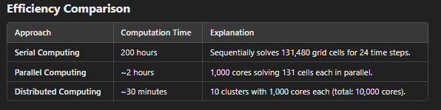

Slide 16
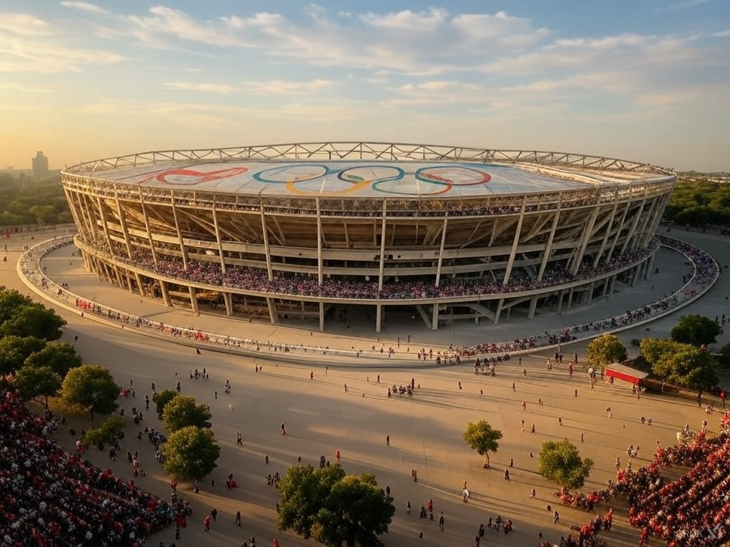
Problem Statement:
Organizing the Olympics involves managing millions of activities simultaneously, including ticketing, scheduling, transportation, security, athlete management, and broadcasting. Handling such a massive event requires efficient systems to process and analyze real-time data across multiple domains.

Slide 17
Challenges in Organizing the Olympics:
Massive Data Volume:
Ticketing for millions of spectators.
Managing schedules for thousands of events.
Broadcasting to billions globally.
Real-Time Operations:
Monitoring athlete locations, event schedules, and real-time crowd management.
Immediate communication across venues.
Scalability:
Handling peak traffic during opening ceremonies or major events.
Coordination Across Regions:
Managing venues in multiple cities (e.g., Delhi, Mumbai, Bangalore).

Slide 18
Proposed Solution Using Parallel and Distributed Computing
Divide the Tasks:
Split tasks across regions, venues, and domains (e.g., ticketing, transportation, security).
Use parallel processing within each domain and distributed systems for cross-domain coordination.

Slide 19
Implementation Steps
Step 1: Ticketing and Visitor Management
Parallel Computing:
Process ticket bookings in parallel across multiple servers.
Each server handles a portion of the user base.
Example:
For 10 million ticket requests, use 1,000 servers, each processing 10,000 requests simultaneously.
Distributed Computing:
Assign each region or venue a separate cluster to handle ticketing locally.
Synchronize clusters to prevent overbooking or conflicts.

Slide 20
Implementation Steps
Step 2: Event Scheduling and Athlete Tracking
Parallel Computing:
Allocate one processor per event to manage scheduling, venue allocation, and time conflicts.
Track athlete locations and readiness in real-time.
Distributed Computing:
Assign each city or venue a cluster to manage events locally.
Clusters communicate to avoid scheduling overlaps for athletes competing in multiple events.
Step 3: Transportation Management
Parallel Computing:
Use traffic simulation models to optimize routes for spectators, athletes, and VIPs.
Divide the city into grids and compute optimal routes for each grid simultaneously.
Distributed Computing:
Assign transportation coordination to regional systems.
Regions share data on traffic congestion or delays for real-time updates.

Slide 21
Implementation Steps
Step 4: Security and Crowd Monitoring
Parallel Computing:
Process video feeds from thousands of CCTV cameras in parallel using AI for threat detection.
Distributed Computing:
Each venue has a local security cluster monitoring video feeds and alarms.
Regional and central clusters aggregate and analyze data for coordinated responses.
Step 5: Broadcasting and Media
Parallel Computing:
Encode and stream live events simultaneously across multiple platforms (YouTube, TV, websites).
Distributed Computing:
Use Content Delivery Networks (CDNs) to distribute streaming loads globally.
Regional servers ensure minimal latency for local viewers.

Slide 22
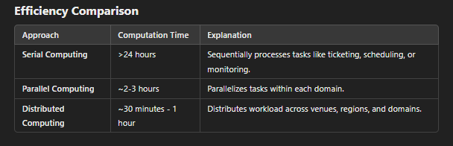
Real-World Example
Tokyo 2020 Olympics:
Used AI-powered distributed systems to manage transportation, scheduling, and security.
Intel's distributed architecture ensured real-time analytics for over 339 events.

Slide 23
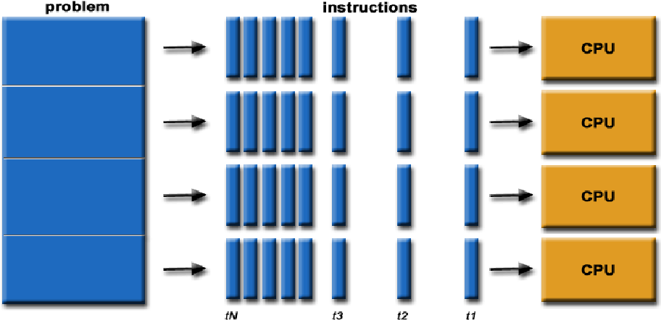
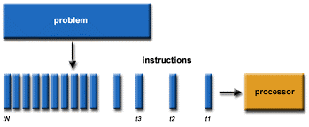
What is Parallel and Distributed Computing
Doing Things Simultaneously
Same thing or different things
Solving Larger Problems

Slide 24
Why Parallel and Distributed Computing is Important?
Handling Big Data:
Modern systems generate massive amounts of data (e.g., social media, IoT). Sequential processing is too slow. Parallel and distributed computing divide tasks across multiple nodes or processors to handle data efficiently.
Real-Time Processing:
Applications like fraud detection, online recommendations, and weather simulations need immediate results. Parallel and distributed systems make this possible by processing tasks simultaneously.
Scalability:
Systems can scale horizontally (adding more nodes) to handle increasing workloads without slowing down.
Improved Fault Tolerance:
Distributed systems replicate data and tasks across nodes, ensuring high availability even if some nodes fail.
Faster Computation:
Breaks large problems into smaller tasks and runs them in parallel, significantly reducing computation time.

Slide 25
Challenges in Parallel and Distributed Computing
Both parallel and distributed computing enable efficiency, scalability, and speed in solving complex problems. However, they come with significant challenges that must be addressed for successful implementation.

Slide 26
Challenges in Parallel Computing
Synchronization Overhead:
Problem: Processes running in parallel often need to communicate or share data, requiring synchronization.
Example: Shared memory systems where multiple threads access the same data can lead to bottlenecks or race conditions.
Impact: Can reduce the performance gains from parallelization.
Load Balancing:
Problem: Unequal distribution of tasks across processors leads to idle resources and inefficiencies.
Example: In weather modeling, some grid cells (e.g., over oceans) require less computation than others (e.g., near cities), leading to workload imbalance.
Impact: Decreases overall system throughput.
Memory Bottlenecks:
Problem: Limited shared memory bandwidth becomes a bottleneck when multiple processors try to access it simultaneously.
Example: GPU computations may slow down if memory transfer between CPU and GPU is inefficient.
Impact: Increases computation time and diminishes parallelism advantages.
Debugging and Testing:
Problem: Errors in parallel programs (e.g., deadlocks, race conditions) are harder to detect and reproduce due to the concurrent nature of execution.
Impact: Makes development and maintenance more complex.

Slide 27
Challenges in Distributed Computing
Network Latency and Bandwidth:
Problem: Communication between distributed nodes introduces latency and consumes bandwidth, particularly for geographically dispersed systems.
Example: In cloud gaming, latency between the user and server can disrupt the gaming experience.
Impact: Reduces the system’s responsiveness and scalability.
Fault Tolerance:
Problem: Ensuring the system continues to function despite node or network failures.
Example: In a distributed database, one node going offline must not affect data consistency or availability.
Impact: Requires sophisticated redundancy mechanisms like replication or consensus algorithms.
Data Consistency:
Problem: Maintaining a consistent state across all nodes in the face of concurrent updates.
Example: In a distributed e-commerce platform, ensuring inventory updates reflect the correct stock levels despite simultaneous orders.
Impact: Often requires trade-offs between consistency, availability, and partition tolerance (CAP theorem).
Heterogeneity of Systems:
Problem: Distributed systems may involve different hardware, operating systems, and network configurations.
Example: Cloud systems where nodes may be a mix of AWS, Azure, and on-premises servers.
Impact: Makes integration and performance optimization challenging.
Security:
Problem: Distributed systems are more vulnerable to cyberattacks due to their multiple entry points.
Example: Distributed Denial of Service (DDoS) attacks exploit the decentralized nature of distributed systems.
Impact: Requires robust security mechanisms like encryption, access controls, and monitoring.
Scalability Issues:
Problem: As the number of nodes increases, overhead from communication and coordination also increases.
Example: Blockchain networks where transaction times slow as the network grows.
Impact: Can limit the system’s ability to scale effectively.

Slide 28
Common Challenges in Both Parallel and Distributed Computing
Partitioning and Decomposition:
Problem: Breaking the problem into tasks that can be efficiently executed in parallel or distributed environments.
Example: In weather prediction, dividing the atmospheric model into regions while accounting for interactions between them.
Impact: Poor decomposition can lead to inefficiencies and dependencies.
Dependency Management:
Problem: Tasks often have dependencies that must be carefully managed to avoid delays or bottlenecks.
Example: In a parallel rendering system, processing one frame depends on the output of the previous frame.
Impact: Reduces parallelism and increases complexity.
Resource Management:
Problem: Allocating and scheduling resources dynamically to meet demand while minimizing costs.
Example: Distributed cloud systems must allocate virtual machines efficiently based on workload spikes.
Impact: Leads to suboptimal resource utilization if not managed well.
Energy Consumption:
Problem: Both parallel and distributed systems can be energy-intensive due to multiple active processors or nodes.
Example: A distributed blockchain system running 24/7 consumes significant energy for consensus algorithms like Proof of Work.
Impact: Adds operational costs and environmental concerns.

Slide 29
CLOUD COMPUTING
NIST, the US National Institute of Standards and Technology, defined cloud
computing as
“a model for enabling ubiquitous, convenient, on-demand network access to a shared pool of configurable computing resources (e.g., networks, servers, storage, applications, and services) that can be rapidly provisioned and released with minimal management effort or service provider interaction.”
Hence, a Cloud has to self-manage its large pool of resources

Slide 30
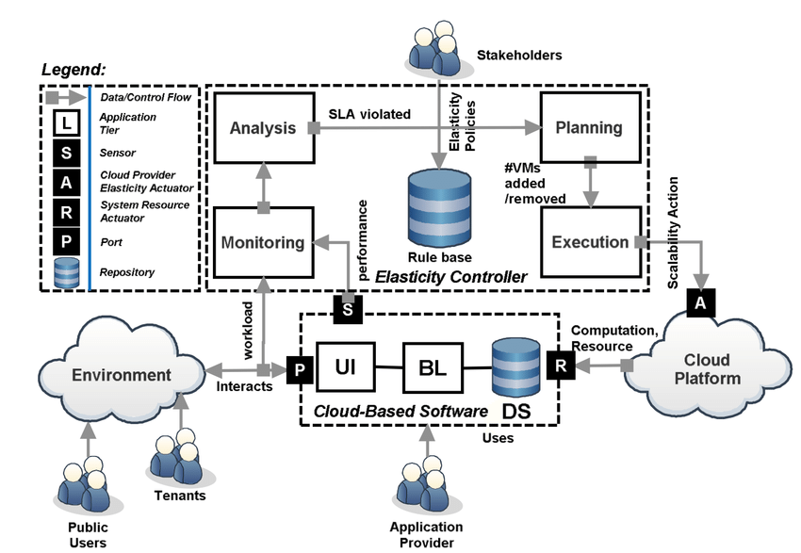
CLOUD COMPUTING
Source : Pahl, Claus & Jamshidi, Pooyan & Zimmermann, Olaf. (2017). Architectural Principles for Cloud Software. ACM Transactions on Internet
Technology. 18. 10.1145/3104028.

Slide 31
Practical Example:
Imagine Netflix during the release of a new blockbuster movie:
Users: Millions of users start streaming the movie.
Cloud-Based Software:
UI: Users navigate Netflix’s homepage.
BL: Business logic identifies which users need the movie stream.
DS: User accounts and streaming metadata are fetched from the database.
Cloud Platform:
AWS or another cloud service runs the backend for streaming videos.
Elasticity Controller:
Monitoring detects high server load.
Analysis identifies a potential SLA violation if resources are not scaled.
Planning decides to add 50 more VMs in regions with peak traffic.
Execution deploys these resources, ensuring smooth streaming for users.

Slide 32
Open Nebula received the following requirements from many leading supercomputing and research centers
Automatic and Elastic Management of the Computing Service. The powerful CLI and APIs exposed by OpenNebula enable its easy integration with any of the most common job management systems (Torque, Open Grid Engine, Platform LSF…) to automatically provision computing worker nodes to meet dynamic demands. The advanced contextualization mechanisms enable the automatic configuration of the worker nodes.
Combination of Physical and Virtual Resources. You can use OpenNebula for the management of the virtual worker nodes in your computer cluster and keep
physical resources for HPC performance-sensitive applications that require high-bandwidth, low-latency interconnection networks.
Management of Several Physical Clusters with Different Configurations. The multiple-zone functionality enables the management of multiple physical clusters
with specific architecture and software/hardware execution environments to fulfill the needs from different workload profiles.
Support for Several VOs. The new functionality to on-demand provision of Virtual Data Centers can be used to provide different VOs with isolated compar tments of
the cloud infrastructure.
Support for Heterogeneous Execution Environments. The new repositories for VM appliances and templates can be used to provide users with pre-defined application environments. The fined-grain access control supports the creation and easy maintenance of the appliance repositories, that could be even private for different Virtual Data Centers (VOs).
Full Isolation of Execution for Performance-sensitive Applications: The functionality for automatic placement of VMs and the configurable monitoring system enable the ability to define isolation levels for the computing services. The new multiple-zone support extends this functionality to easily manage fully isolated physical clusters.
Execution of Complete Computing Clusters: Can deploy multi-tier services consisting of groups of inter-connected VMs and define their auto-configuration at
boot time.
Cloudbursting to Meet Peak Demands: The hybrid cloud functionality enables the deployment of architectures for cloud-bursting to address peak or fluctuating
demands of HTC (High Throughput Computing) workloads.
Management of Persistent Scientific Data: Can make disks persistent, save changes for subsequent new executions, and share the new disks with other users in your Virtual Data Center (VO).
Placement of VMs Near the Input Data: OpenNebula’s scheduler provides automatic VM placement for the definition of workload and resource-aware
allocation policies such as packing, striping, load-aware, or affinity-aware.
Ensure that each Tenant Gets a Fair Share of Resources: OpenNebula’s resource quota management helps allocate, track and limit resource utilization.

Slide 33
Distributed system
“A distributed system is one in which the failure of a computer you didn’t even know existed
can render your own computer unusable.” - Leslie Lamport
A distributed system is a collection of independent entities that cooperate to
solve a problem that cannot be individually solved
A distributed execution is the execution of processes across the distributed system to collaboratively achieve a common goal
The motivation
Inherently distributed computations : Money transfer in banking
Resource sharing : Printer, Network attached Storage, databases, files, distributed databases
Access to geographically remote data and resources : payroll data, supercomputers
Enhanced reliability : Geographically distributed resources are not likely to crash/malfunction at the same time Reliability entails several aspects:
availability, i.e., the resource should be accessible at all times;
integrity, i.e., the value/state of the resource should be correct, in the face of concurrent access from multiple processors
fault-tolerance, i.e., the ability to recover from system failures
Increased performance/cost ratio
Scalability adding more processors does not pose a direct bottleneck for the communication network.
Modularity and incremental expandability Heterogeneous processors may be easily added into the system

Slide 34
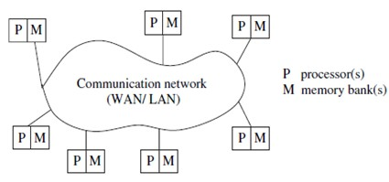
Characteristics of DS
A distributed system can be characterized as a collection of mostly autonomous processors communicating over a communication network and having the following features:
No common physical clock
No shared memory - requires message-passing for communication
Geographical separation - WAN / LAN
Autonomy and heterogeneity - “loosely coupled”

Slide 35
Characteristics of parallel systems
The primary and most efficacious use of parallel systems is for obtaining a higher throughput by dividing the computational workload among the processors.
The tasks that are most amenable to higher speedups on parallel systems are those that can be partitioned into subtasks very nicely, involving much number-crunching and relatively little communication for synchronization.
A parallel system may be broadly classified as belonging to one of three types:
Multiprocessor system
Multicomputer parallel systems
Array Processor
https://acenet-arc.github.io/ACENET_Summer_School_General/02-architecture_of_parallel_computers/index.html

Slide 36
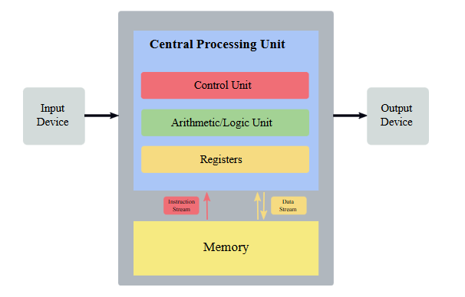
Von Neumann’s Architecture
Von Neumann’s architecture was first published by John von Neumann in 1945. It is based on the stored-program computer concept where computer memory is used to store both program instructions and data. Program instructions tell the computer to do something.

Slide 37
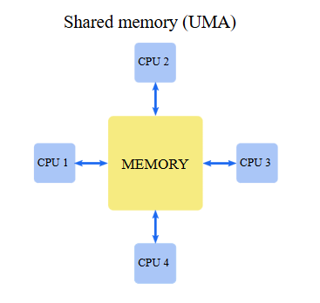
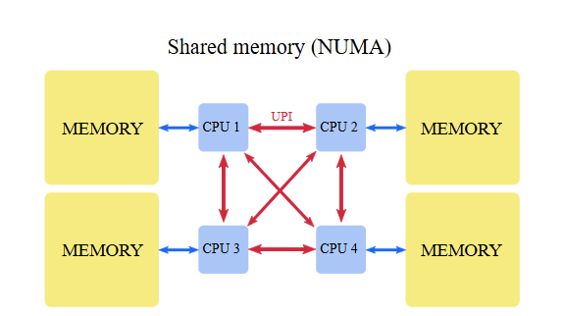
Multiprocessor system
Shared memory System
Multiple processors have direct access to shared memory
which forms a common address space.
Do not have a common clock.
Usually corresponds to a uniform memory access (UMA) architecture
Same Access latency to any memory location from any processor.
All the processors usually run the same operating system
Both the hardware and software are very tightly coupled.
The processors are usually of the same type, and are housed within the same box/container with a shared memory.
The interconnection network to access the memory may be a bus or a multistage switch for greater efficiency

Slide 38
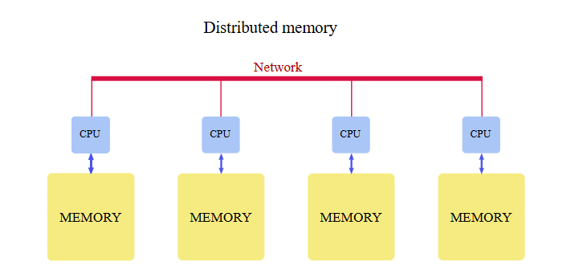
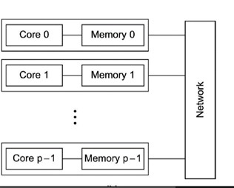
Multicomputer parallel system
Distributed Memory System
Multiple processors do not have direct access to shared memory. May or may not form a common address space in the memory Do not have a common clock.
The processors are in close physical proximity and are usually very tightly coupled (homogenous hardware and software), and connected by an interconnection network.
The processors communicate either via common address space or via message-passing
A multicomputer system that has a common address space usually corresponds to a non-uniform memory access (NUMA) architecture in which the latency to access various shared memory locations from the different processors varies.

Slide 39
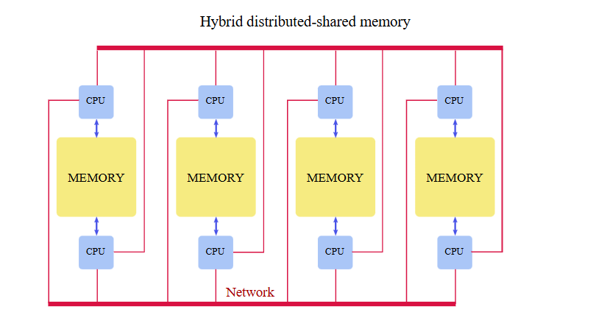
Hybrid Architectures:
Hybrid architectures combine elements of both shared-memory and distributed-memory systems. These architectures leverage the benefits of shared-memory parallelism within individual nodes and distributed-memory scalability across multiple nodes, making them suitable for a wide range of applications.

Slide 40
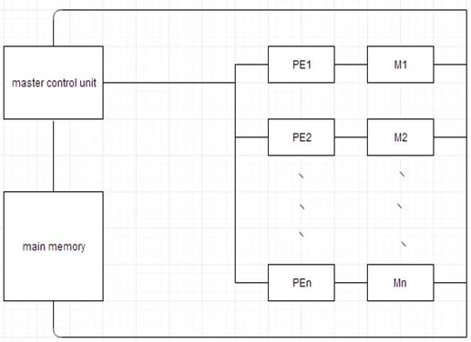
Array Processors
Belong to a class of parallel computers that are physically co-located, are very
tightly coupled, and have a common system clock (but may not share memory
and communicate by passing data using messages).
Perform tightly synchronized processing and data exchange in lock-step for applications such as DSP and image processing
Applications usually involve a large
number of iterations on the data.
Array processors, NUMA and message- passing multicomputer systems are less suitable when the degree of granularity of accessing shared data and communication is very fine.

Slide 41
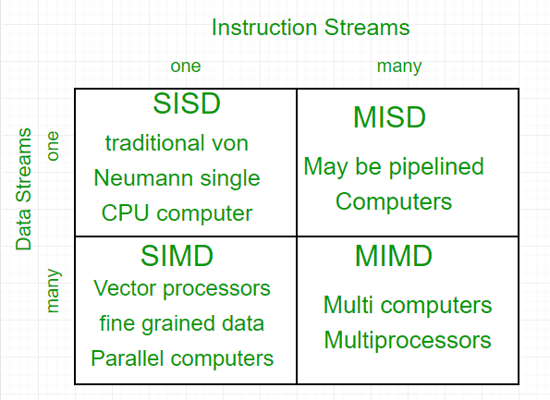
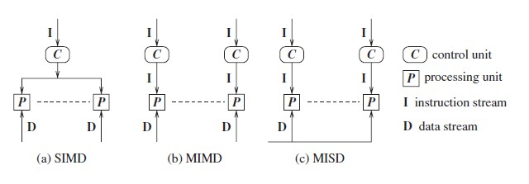
Flynn’s taxonomy
Single instruction stream, single data stream (SISD)
Single instruction stream, multiple data stream (SIMD)
Multiple instruction stream, single data stream (MISD)
Multiple instruction stream, multiple data stream (MIMD)

Slide 42
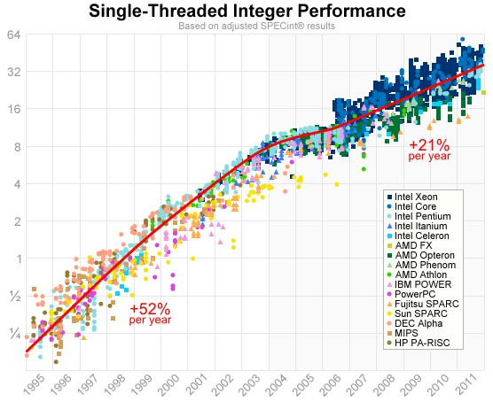
Why parallel computing
From 1986 to 2003
The performance of
microprocessors increased
on average, more than 50% per
year
Since 2003
single-processor performance improvement has slowed
From 2015 to 2017
it increased at less than 4% per year

Slide 43
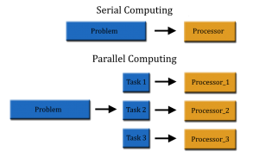
Why we need ever-increasing performance
The vast increases in computational power
Advances in diverse fields
•
Science
Internet
Entertainment.

Slide 44
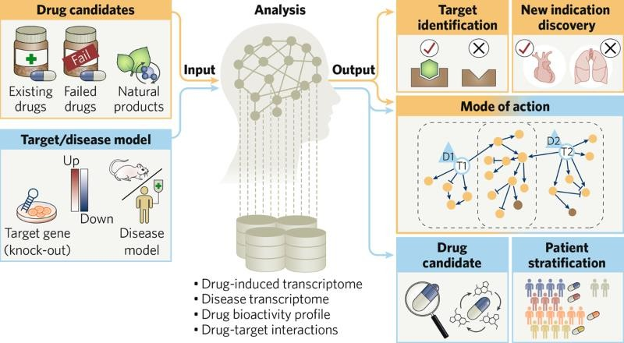
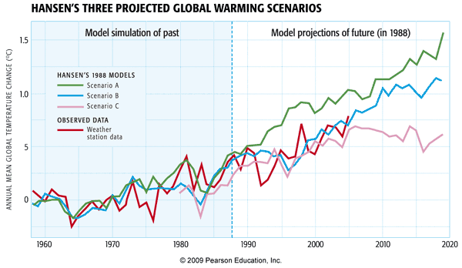
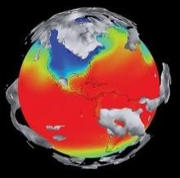
Why we need ever-increasing performance
Science
Climate modelling
Drug discovery
•

Slide 45

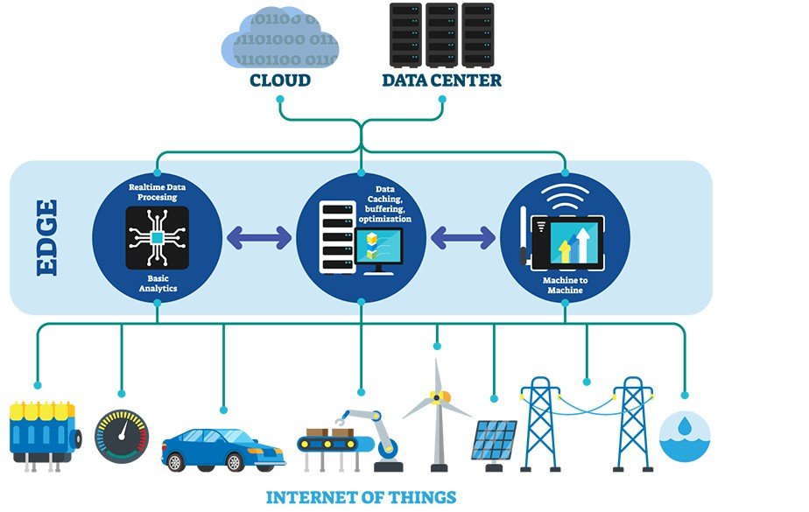

Why we need ever-increasing performance
Internet
Data analytics.
Bitcoin
Internet of Things
•

Slide 46
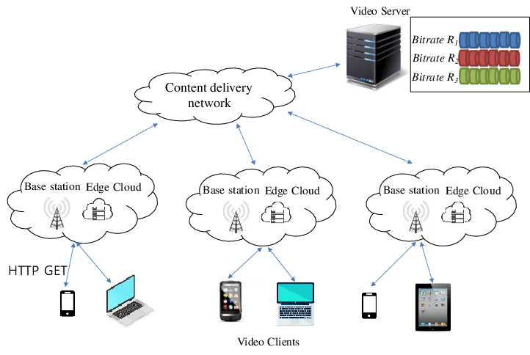
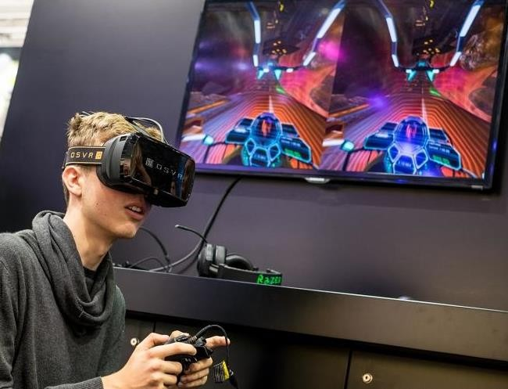
Why we need ever-increasing performance
Entertainment.
Virtual reality
Video servers
•

Slide 47
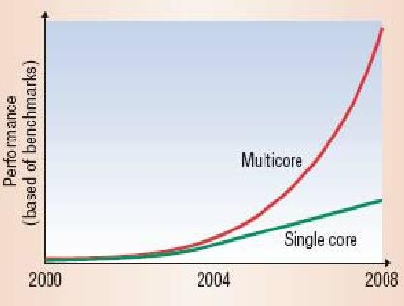
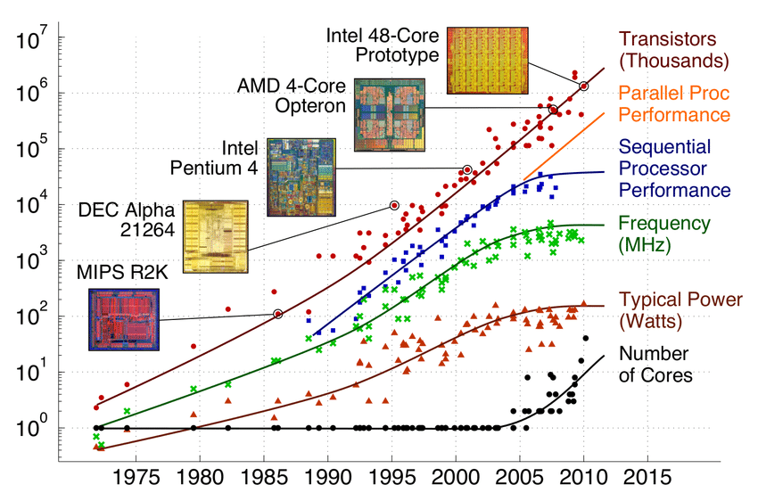
we need ever-increasing performance Why we're building parallel systems
Single-processor Integrated Circuit (IC) .
The size of transistors decreased
speed of transistors increased
overall speed of the IC is increased
Speed of transistors increased
power consumption also increases
Most of this power is dissipated as heat
IC gets too hot, it becomes unreliable
Impossible to continue to increase the speed of ICs

Slide 48
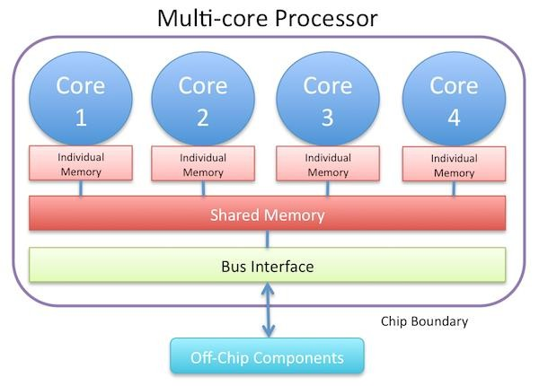
The answer is parallelism.
How then, can we continue to build ever more powerful computers?
Rather than building
ever-faster
more complex
monolithic processors
The industry has decided to put
Multiple
relatively simple
complete processors
on a single chip
Such ICs are called multicore processors
core has become synonymous with CPU
a conventional processor with one CPU is often called a single-core system

Slide 49
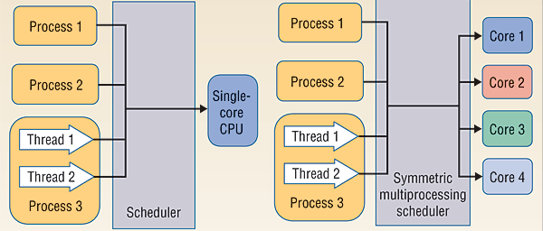
Why we need to write parallel programs
Most programs that have been written for conventional, single-core systems
Cannot exploit the presence of multiple cores.
We can run multiple instances of a program on a multicore system
but this is often of little help
For example, being able to run multiple instances of our favorite game isn't really what we want
we want the program to run faster with more realistic graphics
To do this
we need to either rewrite our serial programs so that they're parallel
so that they can make use of multiple cores
write translation programs, that is, programs that will automatically convert serial programs into parallel programs .
The bad news is that researchers have had very limited success writing programs that convert serial programs in languages such as C, C++, and Java into parallel programs.
While we can write programs that recognize common constructs in serial programs
automatically translate these constructs into efficient parallel constructs,
the sequence of parallel constructs may be terribly inefficient.
multiplication of two matrices as a sequence of dot products
but parallelizing a matrix multiplication as a sequence of parallel dot products is likely to be fairly slow on many systems.
An efficient parallel implementation of a serial program may not be obtained by finding efficient parallelization of each of its steps
Rather, the best parallelization may be obtained by devising an entirely new algorithm.

Slide 50
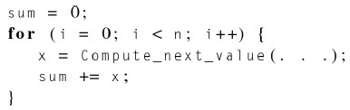
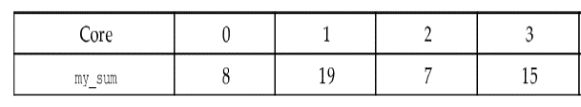
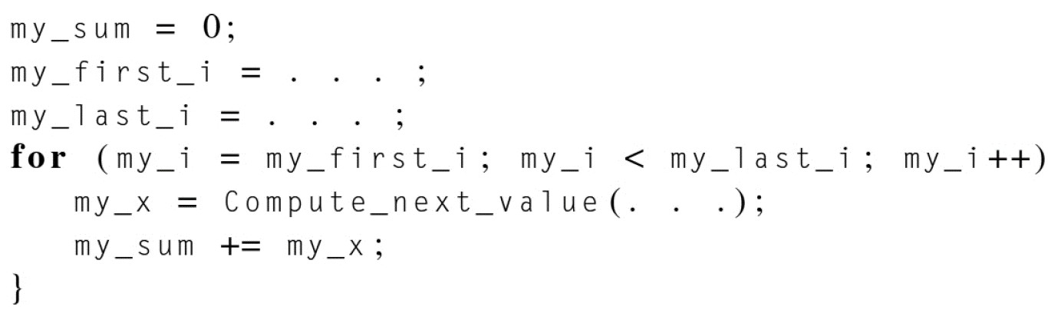
suppose that we need to compute 𝑛 values
and add them together
serial code:
1,4,3,
9,2,8,
5,1,1,
6,2,7
we have 𝑝 cores and 𝑝 ≤ 𝑛 . 𝑝 = 4 & 𝑛 = 12
Then each core can form a partial sum of approximately 𝑛/𝑝 values:

Slide 51
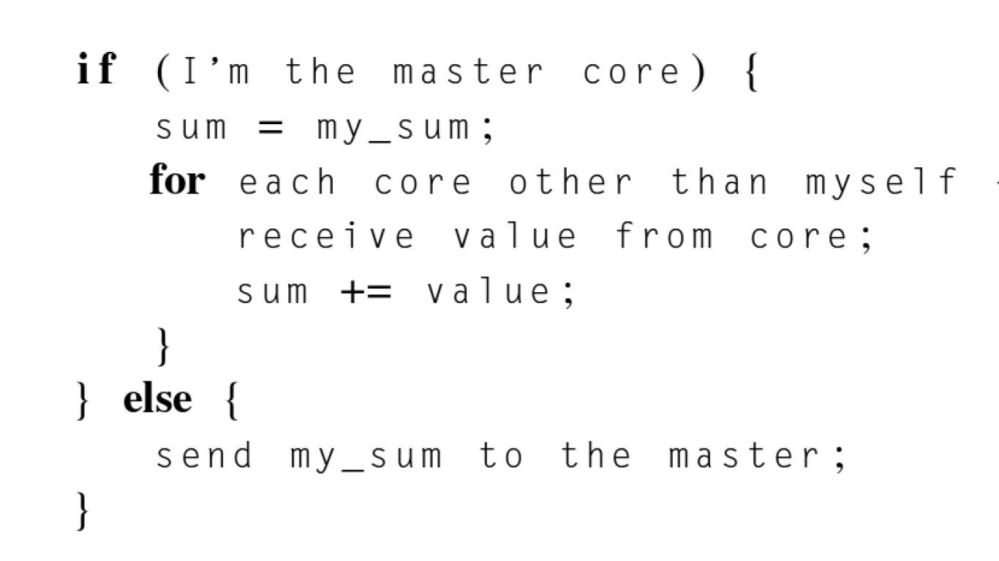
Global sum
“Master” core

Slide 52
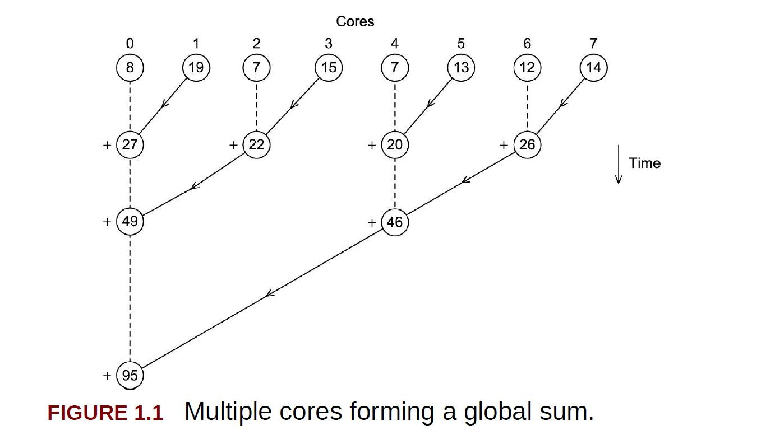
If number of cores is large

Slide 53


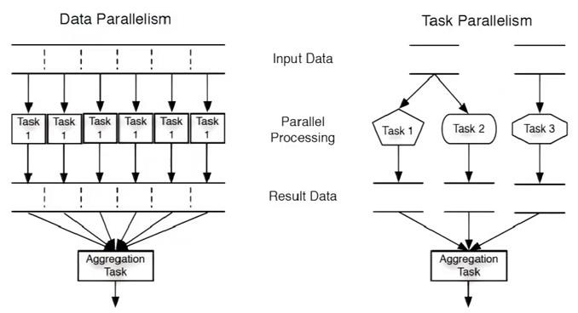
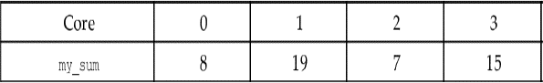



How do we write parallel programs?
Data-parallelism
partition the data used in solving the problem among the cores
each core carries out more or less similar operations on its part of the data
Task-parallelism
partition the various tasks carried out in solving the problem among the cores

Slide 54
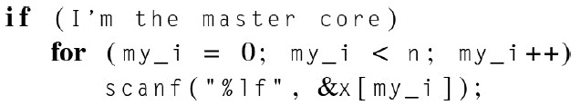
Coordination
among the cores
Communication
one or more cores send their current partial sums to another core.
Load balancing.
Load should be distributed equally
Suppose, one core has to compute most of the values
then the other cores will finish much sooner than the heavily loaded core
and their computational power will be wasted.
Synchronization
suppose that instead of computing the values to be added
the values are read from an array that is read in by the master core
the cores need to wait before starting execution of the code, master core should
initialize

Slide 55
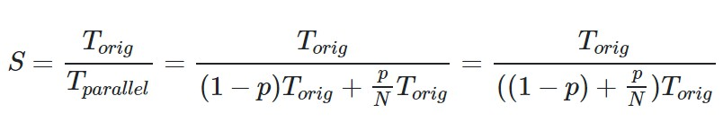
Limits of Parallelism and Scaling
Amdahl’s Law and Strong Scaling
Amdahl’s law provides a theoretical limit to how much faster a program can run if it is parallelized
Amdahl’s law provides a way to quantify the theoretical maximum speedup in latency (also called the speedup factor ) that can occur with parallel execution.
Specifically, Amdahl’s law describes the ratio of the original execution time with the improved execution time, assuming perfect parallelism and no overhead penalty.
P denotes the percent of a program that can be executed in parallel
N denotes the number of parallel execution units
Amdahl’s law states that the theoretical maximum speedup would be:
𝟏
𝑺 =
𝑷
(𝟏 − 𝒑) + _{𝑵}

Slide 56
Gustafson’s Law and Weak Scaling
In perfectly strong scaling, there is no overhead penalty for creating more threads or using more processors. A program run on a system with 100 processors will run in 1/100th of the time than it would on a single- processor system. In contrast, a more realistic and common property is weak scaling, which emphasizes accomplishing more work rather than running in less time. In weak scaling, the additional processors are used to tackle bigger and more complex problems, while holding the expected run time to be the same.
The amount of the improvement is denoted as s.
Limits of Parallelism and Scaling
𝑆 = 1 − 𝑝 + 𝑠 ∗ 𝑝
𝑆 = 0.2 + 5 ∗ 0.8 = 0.2 + 4.0 = 4.2

Slide 57

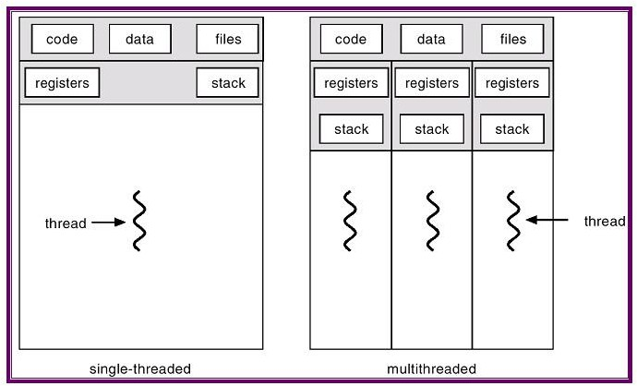


learning to write programs that are explicitly parallel
C language and four different APIs :
➢
Message-Passing Interface
POSIX threads or Pthreads
➢
➢
Compute Unified Device Architecture
GPGPU
CPU+GPU

Slide 58
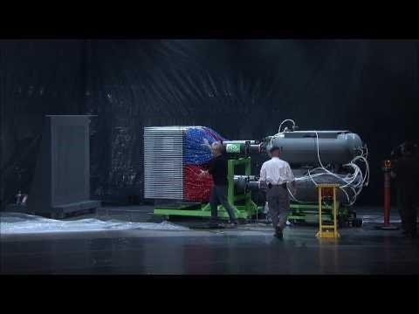
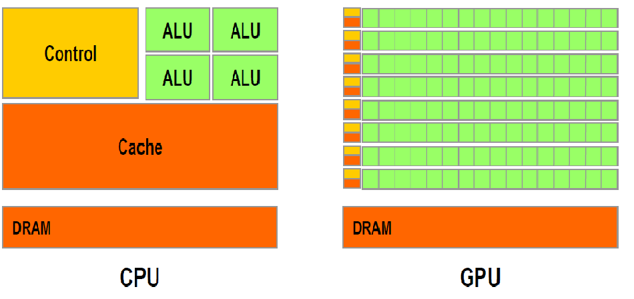
The need to learn four APIs
MPI and Pthreads are libraries of type definitions, functions, and macros that can be used in C programs.
OpenMP consists of a library and some modifications to the C compiler.
CUDA consists of a library and modifications to the C++ compiler.
MPI is an API for programming distributed memory MIMD systems
Pthreads is an API for programming shared memory MIMD systems.
OpenMP is an API for programming both shared memory MIMD and shared memory SIMD systems
CUDA is an API for programming Nvidia GPUs

Slide 59
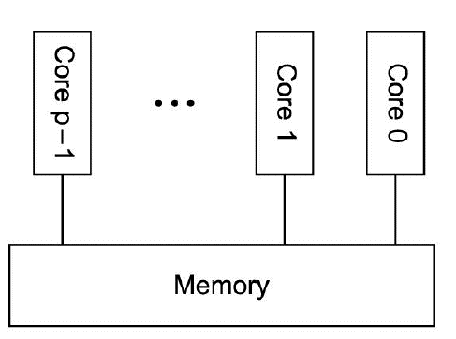
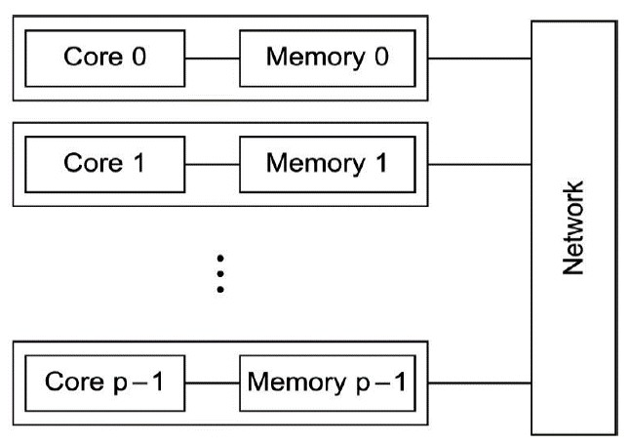
Shared memory and Distributed memory
Shared-memory systems
The cores can share access to the computer's memory
in principle, each core can read and write each memory location
we can coordinate the cores by having them examine and update shared-memory locations
Distributed-memory systems
each core has its own, private memory
the cores can communicate explicitly by sending messages across a network

Slide 60
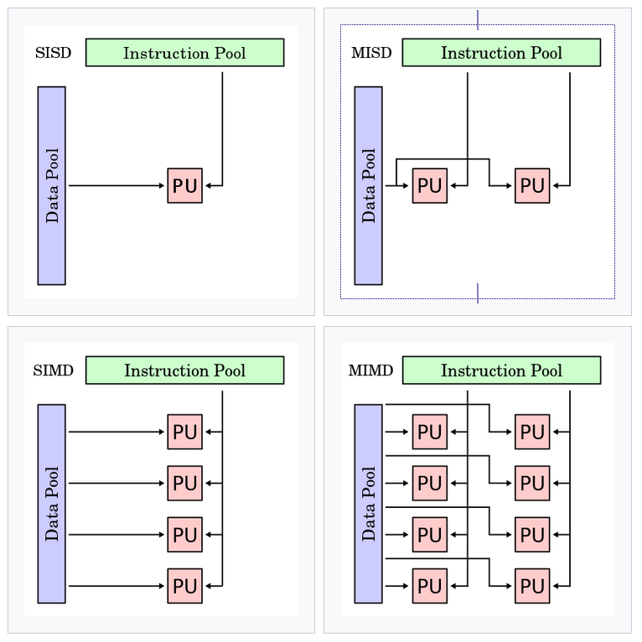
SIMD vs MIMD
Single-Instruction Multiple-Data or SIMD system
Each core can access either its own private memory or memory that's shared among the cores
In this type of system, all the cores carry out the same instruction on their own data
Multiple-Instruction Multiple-Data or MIMD system
Each core can manage its own instruction stream and its own data stream
The cores can be thought of as conventional processors, so they have their own control units, and they are capable of operating independently of each other

Slide 61
Concurrent, parallel, distributed computing
concurrent computing
a program is one in which multiple tasks can be in progress at any instant
parallel computing
a program is one in which multiple tasks cooperate closely to solve a problem
distributed computing
a program may need to cooperate with other programs to solve a problem

Slide 62
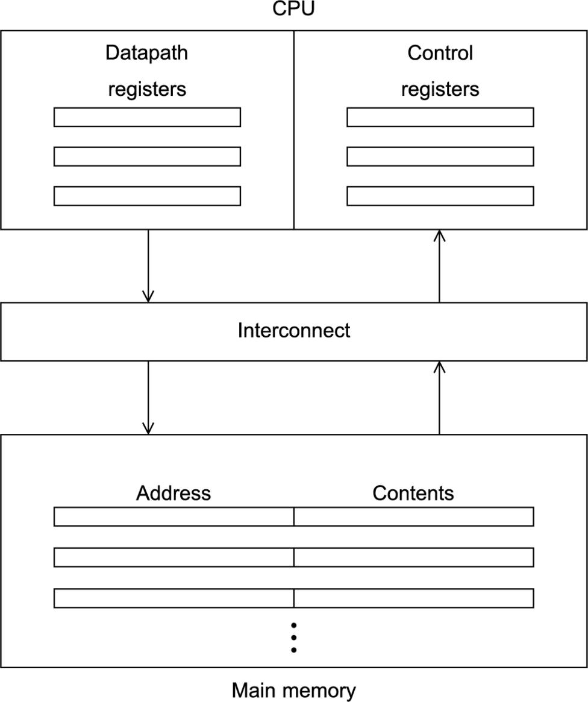
The von Neumann architecture
The separation
of memory and
Von
the
CPU is often called the
Neumann bottleneck, since
interconnect determines the rate at which instructions and data can be accessed.

Slide 63
Operating System, Processes, multitasking, and threads
The operating system, or OS, is a major piece of software
whose purpose is to manage hardware and software resources on a computer.
It determines which programs can run and when they can run.
It also controls the allocation of memory to running programs and access to peripheral devices, such as hard disks and
network interface cards.
When a user runs a program, the operating system creates a process
A process consists of several entities:
The executable machine language program.
A block of memory, which will include the executable code
a call stack that keeps track of active functions
a heap that can be used for memory explicitly allocated by the user program, and some other memory locations.
Descriptors of resources that the operating system has allocated to the process, for example, file descriptors.
Security information—for example, information specifying which hardware and software resources the process can access.
Information about the state of the process, such as
whether the process is ready to run or is waiting on some resource, the content of the registers, and information about the
process's memory.

Slide 64
Multitasking, Threading
Most modern operating systems are multitasking
simultaneous execution of multiple programs
even on a system with a single core
each process runs for a small interval of time - time slice
In a multitasking OS, if a process needs to wait for a resource
It will block. It will stop executing and the OS can run another process.
However, many programs can continue to do useful work even though the part of the program that is currently executing must wait on a resource.
An airline reservation system that is blocked waiting for a seat map for one user could
provide a list of available flights to another user.
Threading provides a mechanism for programmers to divide their programs into more or less independent tasks, with the property that when one thread is blocked, another thread can be run.

Slide 65
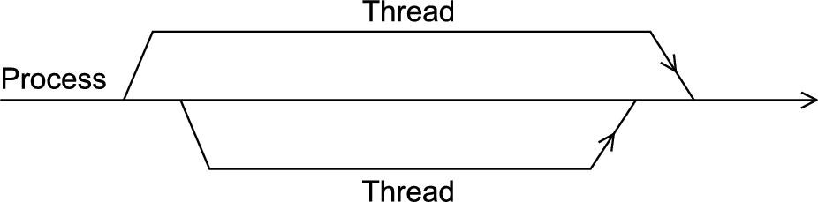
Threads are “lighter weight” than processes
Switching between threads is much faster than switching between
processes
If a process is the “master” thread of execution and threads are started and
stopped by the process
when a thread is started, it forks off the process; when a thread terminates, it
joins the process.

Slide 66
Improvements to the von Neumann model
Caching, Virtual memory, and Low-level parallelism
Cache memory is a special memory that is effectively closer to the registers in the CPU
Multilevel caches - don't duplicate information
L1 miss and an L2 hit
Virtual memory
main memory can function as a cache for secondary storage
page table is used to translate the virtual address into a physical address
the page table doesn't have a valid physical address for the page and the
page is only stored on disk
then the attempted access is called a page fault

Slide 67
Instruction-level parallelism
Pipelining
functional units are arranged in stages
Multiple issue
multiple instructions can be simultaneously initiated
functional units are scheduled at compile time
multiple issue system is said to use static multiple issue
scheduled at run-time
dynamic multiple issue.
A processor that supports dynamic multiple issue is superscalar

Slide 68
Hardware multithreading
Attempts to provide parallelism through the simultaneous execution of different threads
a coarser-grained parallelism than ILP,—threads—are larger or coarser than the finer- grained units—individual instructions
In fine-grained multithreading
the processor switches between threads after each instruction
skipping threads that are stalled
drawback that a thread that's ready to execute a long sequence of instructions may have to wait to execute every instruction
Coarse-grained multithreading attempts to avoid this problem
by only switching threads that are stalled waiting for a time-consuming operation to
complete (e.g., a load from main memory)
Simultaneous multithreading
a variation on fine-grained multithreading. It attempts to exploit superscalar processors by allowing multiple threads to make use of the multiple functional units

Slide 69
Flynn's taxonomy - Classifications of parallel computers
A classical von Neumann system
is a single instruction stream, single data stream, or SISD system
executes a single instruction at a time and computes a single data value at a time
Single instruction, multiple data, or SIMD
systems are parallel systems
operate on multiple data streams
by applying the same instruction to multiple data items
Vector processors
operate on arrays or vectors of data
while conventional CPUs operate on individual elements or scalars
Graphics processing units
Typical GPUs can have dozens of cores, and these cores are also capable of executing independent instruction streams.
So GPUs are neither purely SIMD nor purely MIMD
GPUs are becoming increasingly popular for general, high-performance computing,
several languages have been developed that allow users to exploit their power.

Slide 70
Multiple instruction, multiple data, or MIMD, systems
support multiple simultaneous instruction streams operating on multiple
data streams.
MIMD systems typically consist of a collection of fully independent processing
units or cores, each of which has its own control unit and its own datapath
MIMD systems are usually asynchronous, that is, the processors can operate at their own pace

Slide 71
Distributed-memory systems
The most widely available distributed-memory systems are called clusters.
A collection of commodity systems
the nodes of these systems, are usually shared-memory systems with one or
more multicore processors
distinguish such systems from pure distributed-memory systems
they are sometimes called hybrid systems.
The grid provides the infrastructure necessary to turn large networks of geographically distributed computers into a unified distributed-memory system.
In general, such a system is heterogeneous, that is, the individual nodes are
built from different types of hardware.

Slide 72
Labs
Lab 1: Heart-beat and membership
Lab 2 : Parallel and distributed data processing
Labs 3&4 :High performance using Multithreading
Lab 5 : Scalability
Lab 6: GPU programming
Lab 7 : Event-driven Programming

Slide 73
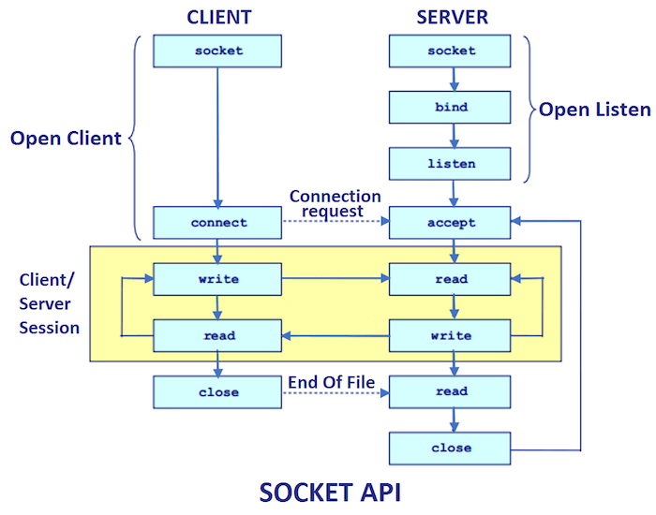
Socket Programming
Client-server communication
Discover node health
Communication failures
Secure socket layer, ssh-keygen
In a cluster with dynamic membership, nodes can leave and rejoin or crash and rejoin

Slide 74
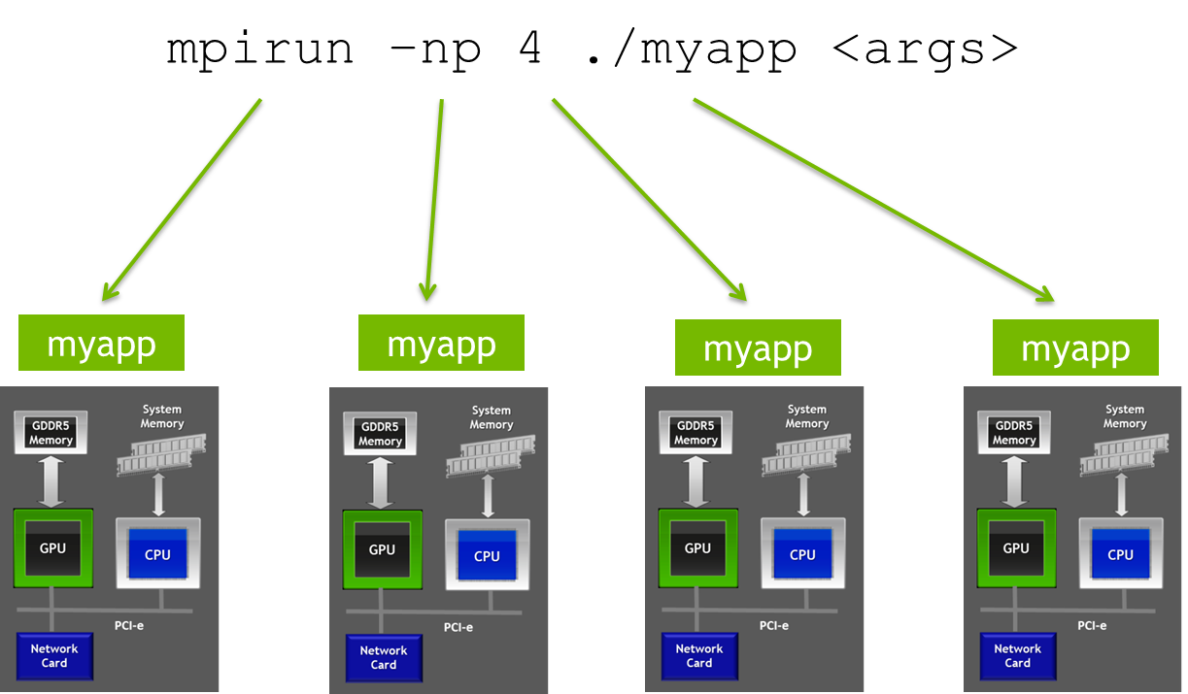
OpenMPI – Distributed Memory parallelism
#include <iostream> #include <mpi.h>
int main(int argc, char** argv) {
// Initialisation MPI_Init(&argc, &argv);
// Reading size and rank
int size, rank;
MPI_Comm_size(MPI_COMM_WORLD, &size); MPI_Comm_rank(MPI_COMM_WORLD, &rank);
// Printing
std::cout << "Hello world, from process #" << rank<< std::endl;
// Finalisation MPI_Finalize(); return 0;
}

Slide 75
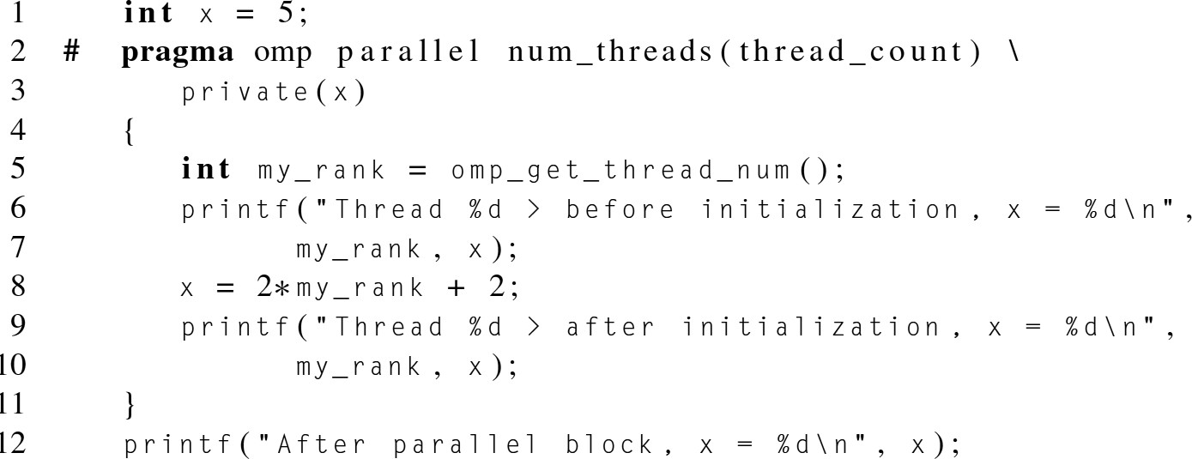

OpenMP – Shared Memory Parallelism

Slide 76


GPU & CUDA – Massive Parallelism

Slide 77

Event driven programming
Queues
Publish / subscribe
Event-driven means, that the process will monitor its file descriptors (and sockets), and act only when some event occurs on some descriptor (events are: data received, error, became writeable

Slide 78
Use Cases of Big Data, High-Performance Data Analytics and HPC
Fraud Detection
PayPal saved over $700 million in fraudulent transactions that they would not have detected previously.
On a daily basis, they deal with 10+ million logins, 13 million transactions and 300
variables that are calculated per event to find a potentially fraudulent transaction
Personalized Medicines and Drug Discovery
Reduced time to find the right proteins, eventually saving a lot of lives.
Smart Energy Grids
Forecasting the energy requirements
Manufacturing Simulation Analysis
simulation analysis can save companies a lot of money when developing new products

Slide 79


HPC Storage

Slide 80
PDS as cloud services
Google Firebase
Google Cloud DNS
Amazon Elastic MapReduce
Amazon managed Blockchain
Building recommendation systems on Google Cloud: Matrix Factorization in BigQuery Machine Learning
Google's globally distributed edge points of presence for Content Delivery Network
Azure high-performance computing (HPC)
Google Cloud GPUs

Slide 81



PDS & HPC for AI in the Cloud
The link between AI and HPC is symbiotic as HPC powers AI workloads,
but AI can identify improvements in HPC data centers.
AI, for example, can optimize heating and cooling systems, reducing electricity costs and improving efficiency. AI systems can also monitor the health of servers, storage, and networking gear, check to see that systems remain correctly configured, and predict when equipment is about to fail.
Furthermore, AI can be used for security purposes, screening and analyzing incoming and outgoing data, detecting malware, and implementing behavioral analytics to protect data.

Slide 82


Slide 83
Thank You!
Parallel
Performance
And
Distributed
Systems
Availability
Durability
Scalability

